Slide 1

MACHINE LEARNING CASE STUDY -SWATHI VADDINENI -AP22110010204

Slide 2
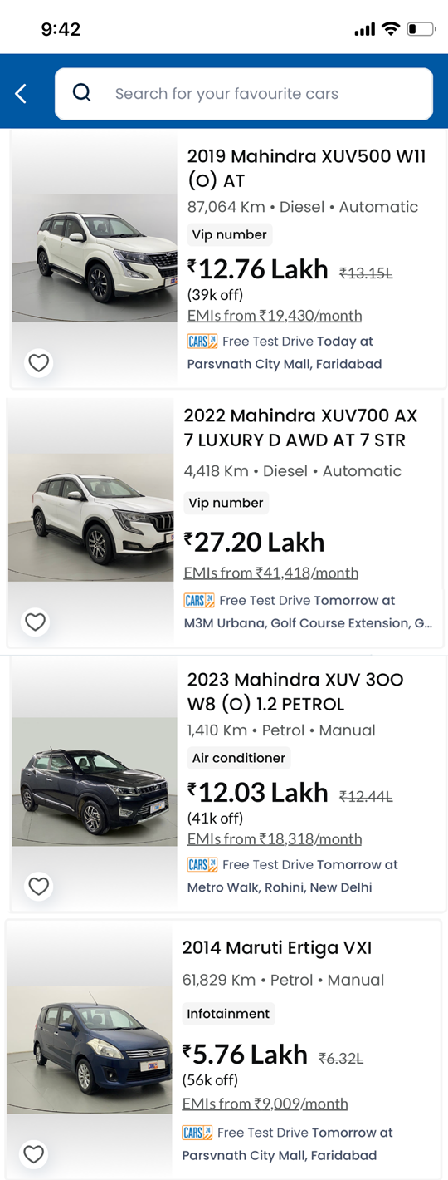

Slide 3

WHAT ARE RECOMMENDER SYSTEMS ?
A recommender system in Cars24 is a data-driven tool that analyzes user preferences, behaviors, and interactions to suggest relevant used cars. By employing algorithms like collaborative filtering and content-based filtering, it personalizes recommendations based on factors such as a user’s search history and the popularity of cars among similar users. The goal is to enhance the car-buying experience by making it easier for users to find vehicles that match their needs and preferences. CARS24, India’s leading online preowned car buying and selling platform, is constantly innovating to enhance user experiences. Every month millions of users visit our platform in search of their dream cars. In this blog, we delve into our journey of refining our personalized car ranking models for search & listings through the power of macine learning.

Slide 4
TYPES OF RECOMMENDER SYSTEMS
-> CONTENT BASED FILTERING
-> COLLABORATIVE-BASED FILTERING

Slide 5
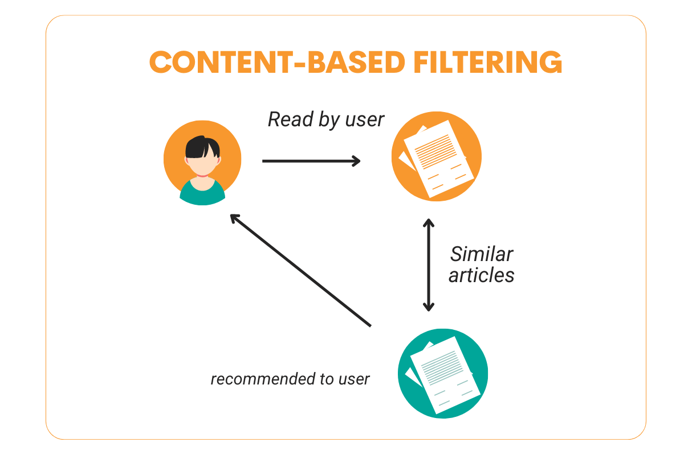
CONTENT-BASED FILTERING
-> Content-based filtering for Cars24 focuses on delivering personalized car recommendations to users by analyzing both the attributes of the cars and the preferences of individual users. Here’s a more structured overview of how this system works, its importance, and its potential impact.
Key Elements of Content-Based Filtering in Cars24
1. User Profile Development
Data Collection: Gather information about user preferences through interactions (e.g., cars viewed, saved searches, and feedback).
Preference Modeling: Create a user profile that reflects preferred car attributes such as make, model, price range, and features.
2. Car Feature Representation
Attributes: Define key features of cars available on the platform, such as:
Make and Model: Identifies the brand and type of vehicle.
Year: Indicates how recent the car is.
Mileage: Represents the distance the car has been driven.
Engine Type: Specifies fuel type (e.g., petrol, diesel, electric).
Condition: Indicates whether the car is new, used, or certified pre-owned.
Data Encoding: Convert categorical features into numerical representations for analysis (e.g., one-hot encoding).
3. Similarity Calculation
Algorithms: Use methods like cosine similarity or Euclidean distance to assess how closely a car’s features match a user’s preferences.
Feature Weighting: Adjust the importance of certain features based on user feedback or historical data (e.g., if a user values safety ratings highly).
4. Recommendation Generation
Filtering: Based on similarity scores, filter out cars that don’t match user preferences.
Ranking: Rank the remaining cars to present the most relevant options first.
Diversity Enhancement: Ensure a varied set of recommendations to expose users to different makes and models.

Slide 6
HERE IS AN EXAMPLE OF CONTENT BASED FILTERING ON CARS’24
EXAMPLE
User Profile Creation:
User: Alice
Preferences:
Make: Toyota
Model: SUV
Year: 2018 or newer
Mileage: Under 30,000 km
Price Range: ₹10,00,000 to ₹15,00,000
Features: Must have a sunroof and advanced safety features
Step-by-Step Example of Content-Based Filtering
1. Data Collection
User Interactions: Alice frequently views listings for Toyota SUVs and saves a few models that fit her criteria.
User Feedback: She rates a couple of cars highly, reinforcing her preference for features like sunroofs and safety ratings.
2. Car Feature Representation
Car Listings: The platform has multiple Toyota SUVs with the following features:
Toyota Fortuner
Year: 2021
Mileage: 15,000 km
Price: ₹14,00,000
Features: Sunroof, advanced safety features
Toyota RAV4
Year: 2019
Mileage: 25,000 km
Price: ₹13,50,000
Features: Sunroof, standard safety features

Slide 7
Toyota Innova Crysta
Year: 2017
Mileage: 35,000 km
Price: ₹12,00,000
Features: No sunroof, advanced safety features
3. Similarity Calculation
The system analyzes the attributes of the cars against Alice’s preferences. Using a similarity algorithm, it calculates scores based on factors like:
Match of make and model
Year of manufacture
Mileage
Price
Presence of desired features
4. Recommendation Generation
Based on the similarity scores, the platform generates a list of recommended cars for Alice:
Toyota Fortuner
Score: High (matches all criteria)
Toyota RAV4
Score: Medium (matches most criteria but has only standard safety features)
Toyota Innova Crysta
Score: Low (does not have a sunroof)
5. Presentation to User
Alice logs in and sees her recommended list:
Top Recommendation: Toyota Fortuner (perfect match)
Second Recommendation: Toyota RAV4 (close match, but with a note about safety features)
Third Recommendation: Toyota Innova Crysta (shown for diversity but flagged as less relevant)
6. User Interaction and Feedback
Alice views the top recommendation and clicks to learn more. She rates the Toyota Fortuner positively.
The system updates her profile, reinforcing her interest in features like the sunroof and safety ratings.

Slide 8
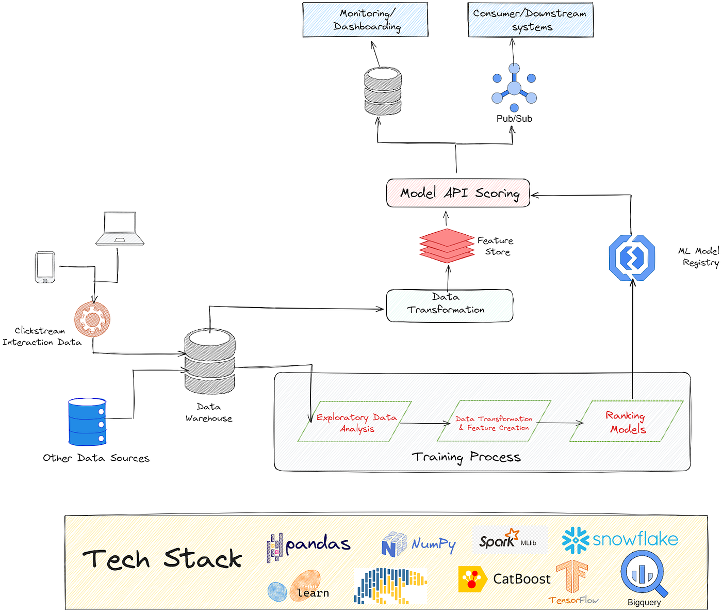
COLLEBORATIVE- BASED FILTERING
-> Collaborative-based filtering is a popular recommendation system technique that suggests items to users based on the preferences and behaviors of similar users. This approach relies on the idea that if users have historically agreed on certain items, those items are likely to be relevant to one another.
Key Components of Collaborative-Based Filtering
1. User-Item Interactions
Data Collection: The system collects data on user interactions with items, such as:
Ratings (e.g., star ratings given to cars)
Purchases (cars bought)
Clicks or views (cars viewed but not purchased)
Implicit Feedback: Some systems use implicit data, such as time spent on a listing or frequency of interactions, instead of explicit ratings.
2. User Similarity Calculation
Finding Similar Users: The system identifies users who have similar preferences or behaviors. Common methods include:
Cosine Similarity: Measures the cosine of the angle between two user vectors in a multi-dimensional space.
Pearson Correlation: Assesses the linear correlation between two users’ ratings.
Neighborhood Methods: Users can be grouped into "neighborhoods" based on similarity scores, allowing the system to recommend items favored by similar users.
3. Recommendation Generation
Item Recommendation: For a given user, the system recommends items that other similar users liked or rated highly. This process typically involves:
Weighted Average: Calculate a score for each item based on ratings from similar users, weighted by their similarity to the target user.
Diversity and Filtering: To enhance user experience, recommendations might also consider item diversity or filter out items the user has already interacted .

Slide 9
HERE IS AN EXAMPLE OF COLLEBORATIVE BASED FILTERING:
User-Based Collaborative Filtering for Car Recommendations: Suppose User A and User B have similar browsing patterns on Cars24—both have been exploring compact SUVs in the $15,000 to $20,000 range. If User A recently viewed or purchased a Honda CR-V, Cars24 could recommend a Honda CR-V or similar SUV models to User B, based on their shared interest in this vehicle category.
Popular Model Suggestions Based on Similar Users' Searches: If a significant number of users who viewed a Maruti Suzuki Swift also checked out a Hyundai i20, Cars24 might suggest the Hyundai i20 to new users viewing the Maruti Suzuki Swift. This approach leverages data on viewing habits to connect users to models they might not have initially considered.
Recommendations by Features Preferred by Similar Users: Collaborative filtering could recommend cars based on features that appeal to similar users. For example, if users who often search for cars with automatic transmissions and sunroofs frequently end up buying Toyota models, Cars24 might prioritize showing Toyota cars with these features to users with similar browsing patterns.
Price-Based Recommendations in Popular Segments: Cars24 could recommend vehicles based on typical spending patterns. For instance, if users browsing cars under $10,000 frequently view hatchbacks, a user looking at budget cars might receive more recommendations for hatchbacks, as this segment might interest them based on collective user behavior.
Top-Selling Models in Local Areas: By using collaborative filtering, Cars24 could suggest car models that are popular in a specific location. If people in a city favor certain fuel-efficient cars due to local commute patterns, the platform might suggest these popular models to new users from the same area, assuming they might share similar needs.
Suggested Alternatives Based on Previous Purchases: If a user previously bought a sedan, Cars24 could suggest other sedans or popular crossovers that people with similar past purchases found interesting. This could be helpful for users looking to upgrade or switch cars.

Slide 10



IMPLEMENTING RECOMMENDER SYSTEM ON THE CARS’24 APP
-> Implementing a recommender system on the Cars24 app through the lens of information theory involves leveraging concepts like entropy, mutual information, and information gain to enhance the precision and personalization of recommendations.

Slide 11


